Slide 1
Techniques for Microscopic Study of Bacteria
Lecture for
DI
22-04-2020
Speaker: Dr. Pankaj Kumar
Department of Botany,
Purnea College, Purnia

Slide 2
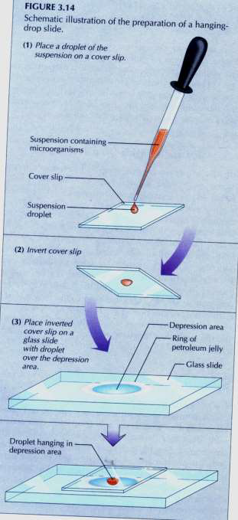
Techniques for Microscopic Study of Bacteria
1. Wet-Mount and Hanging-Drop Techniques
use to examine living organisms
useful in the study of morphology, internal cell structures, motility or cell changes
2. Staining Techniques
use dyes (colored organic cpds) to stain microorganisms
used to show the overall structure of microorganisms, to identify their internal structures, and to help identify and separate similar organisms

Slide 3
Major Steps in preparing a stained microbial specimen for microscopic examination are:
Placing a smear (or thin film of specimen), on a glass slide
2. Fixing the dried smear onto the slide with heat to make the microorganisms stick to the glass
3. Staining with one or more dyes

Slide 4
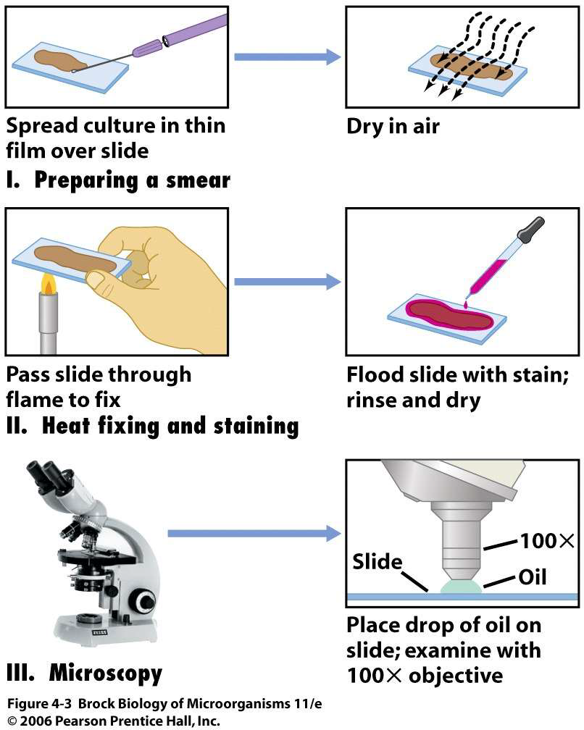

Slide 5
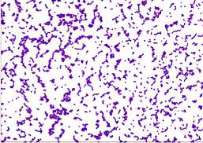
Types of Staining Techniques
1. Simple Staining:
film stained with a single dye solution
shows size, shape and arrangement of cells
2. Differential Staining
Two or more reagents used in staining process
Difference observable between cells or part of cells.

Slide 6
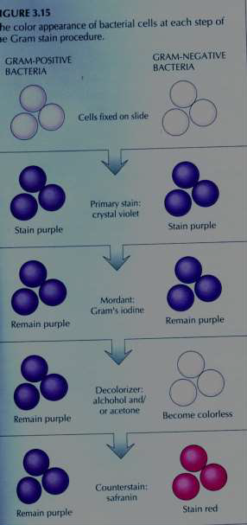
3. Gram staining
One of the most important and widely used differential staining tech. for bacteria
1st described in 1884 by Christian Gram of Denmark .
Primary stain (crystal violet) applied to film and then treated with reagents and counterstained with safranin
characterizes bacteria in one of two groups:
1. Gram-positive – deep violet
2. Gram negative - red

Slide 7
Cont..
4. Acid-fast:
Film stained with carbolfuchsin, decolorized, and counterstained with methylene blue
Separate acid-fast bacteria, those not decolorized when acid solution is applied(e.g. Mycobacteria), from non-acid –fast bacteria, which are decolorized by acid
5. Giemsa Stain:
Stain applied to blood smear or film of other specimens
Observation of protozoa in blood smear; rickettsia (small parasitic bacteria) in certain cells of the nucleus; nuclear material in bacteria

Slide 8
Cont..
6. Endospore:
Primary stain (malachite green) applied with heat to penetrate spores; vegetative cells counterstained with safranin
Endospores can be seen in Bacillus and Clostridium species
7. Capsule:
Smear stained following treatment with copper sulfate
Can be observed as a clear zone surrounding cells of capsulated microorganisms

Slide 9
Cont..
8. Flagella:
mordant acts to thicken flagella before staining
observe flagella on bacteria
9. Negative staining:
specimen mixed with India ink and spread into thin film.
study morphology; staining procedure and reagents are very mild in their effect on the microorganism, called a negative stain because microorganism is unstained and is made visible and is made visible because the background is dark.

